Slide 1
ARCHER: UK National HPC Service
Nottingham HPC User Conference 2017
Iain Bethune
i.bethune@epcc.ed.ac.uk @iainbethune

Slide 2

Reusing this material
This work is licensed under a Creative Commons Attribution-NonCommercial-ShareAlike 4.0 International License.
http://creativecommons.org/licenses/by-nc-sa/4.0/deed.en_US
This means you are free to copy and redistribute the material and adapt and build on the material under the following terms: You must give appropriate credit, provide a link to the license and indicate if changes were made. If you adapt or build on the material you must distribute your work under the same license as the original.
Note that this presentation contains images owned by others. Please seek their permission before reusing these images.

Slide 3
Outline
Service Overview
ARCHER Hardware & Software
Routes to access
CSE Support
Scientific Software Packages
Training
Embedded Computational Science and Engineering (eCSE) Funding
Cirrus Tier-2

Slide 4
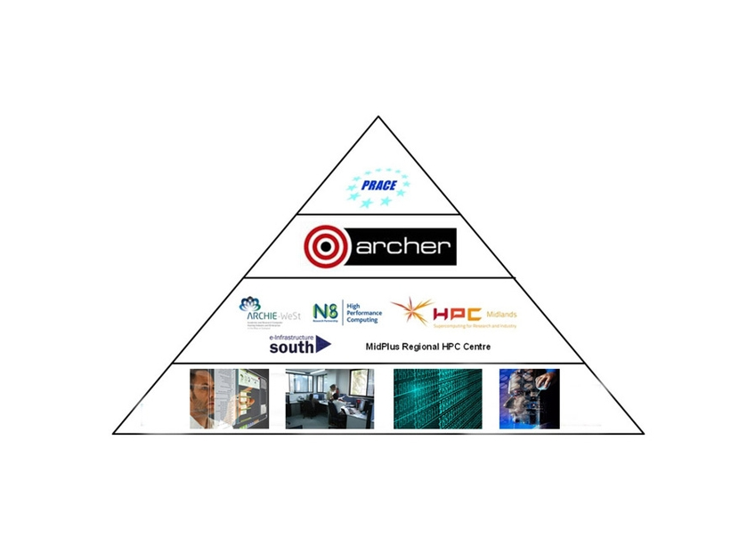
Service Overview
National HPC Service(s)?
Tier-0: International
Tier-1: National
Tier-2: Regional
Tier-3: Institutional/
Departmental / Group

Slide 5
Service Overview
UK National Supercomputing Service
2013-2018
Follow-on from HECToR, HPCx, CSAR …
Funded by EPSRC and NERC
Managed by EPSRC
Service provision, accommodation and Computational Science and Engineering (CSE) support service by EPCC
Hardware provided by Cray
www.archer.ac.uk

Slide 6
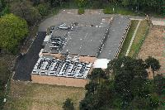
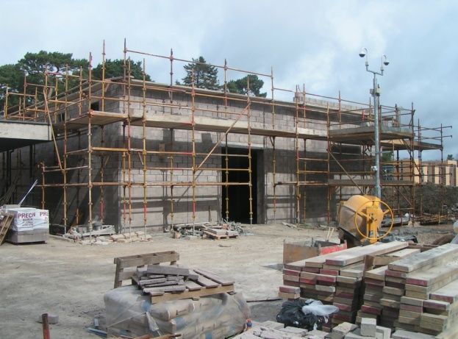
Service Overview
Advanced Computing Facility (ACF)
Purpose built, secure, world-class facility
Houses wide variety of leading-edge systems and infrastructures
National services
ARCHER
Cirrus (EPCC Tier-2)
IBM BlueGene/Q (DiRAC)
UK Research Data Facility (RDF)
Local services
ECDF, EDIM1 – DIR machine
Major expansion for ARCHER
6MW, 850m² plant room, 550m² machine
HECToR PUE = 1.25, ARCHER PUE < 1.1
Notes:
Room for expansion
Built for the future

Slide 7
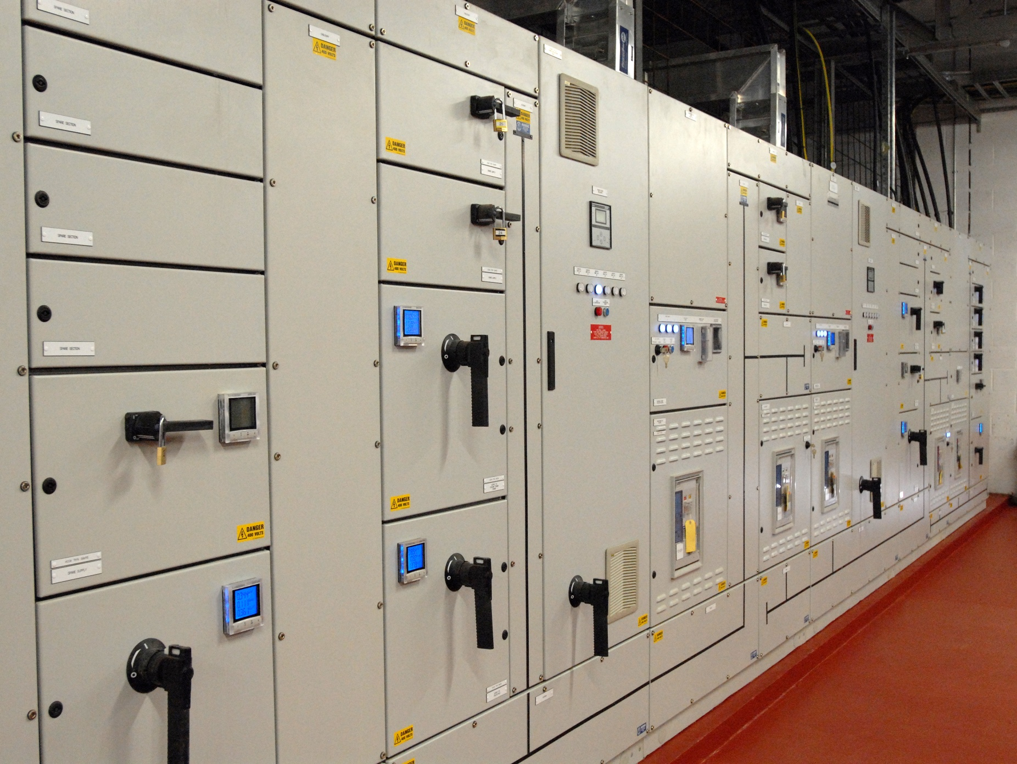
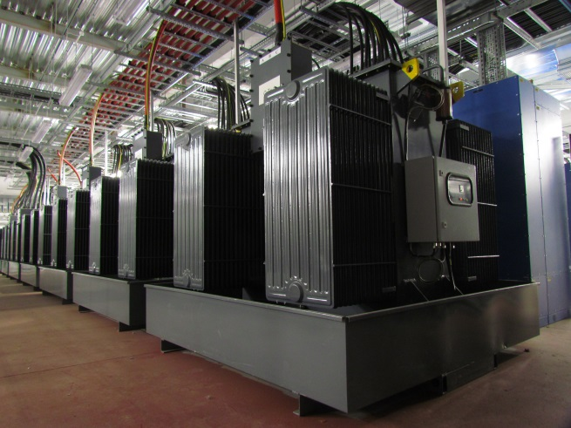
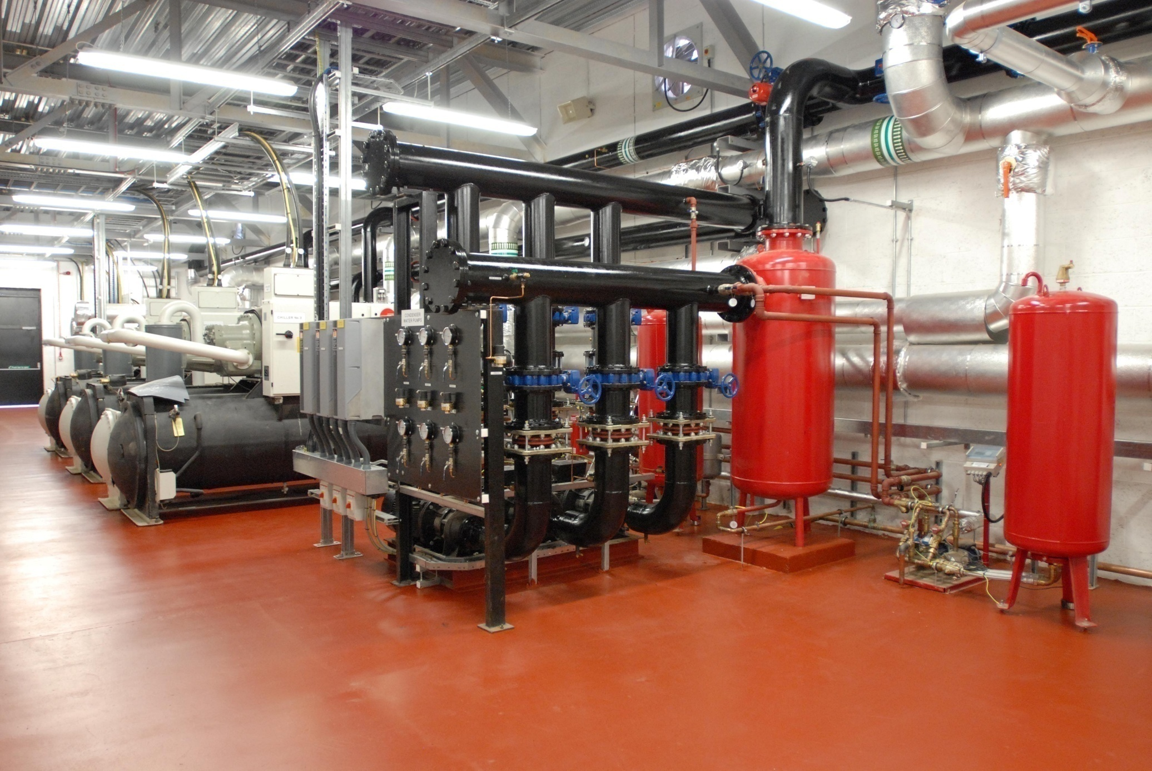
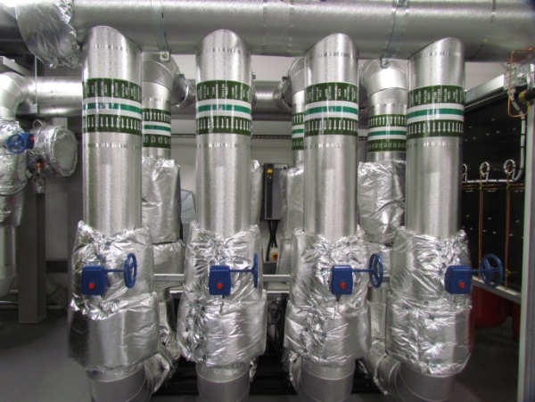

Slide 8

ARCHER Hardware
Cray XC30 architecture
4920 nodes:
24 Intel Ivy Bridge cores per node ➔ 118,080 cores
Most nodes have 64 GB memory (~2.3 GB/core)
1 group (376 nodes) have 128 GB memory (~5.6 GB/core)
Cray Aries interconnect with Dragonfly all-to-all topology
~1.4us latency, 11 TB/s bisectional bandwidth
4.4 PB high performance parallel filesystem (Lustre)
Direct access to Research Data Facility (20PB disk + backup tape)

Slide 9
ARCHER Hardware
ARCHER Knights Landing (KNL) platform
12 nodes:
64 core Intel Xeon Phi 7210 processor
96 GB main memory and 16GB high-bandwidth MCDRAM
Cray Aries interconnect
Similar programming environment to ARCHER
Home filesystem shared with ARCHER
Intended for trialling applications on KNL
Opportunity to experiment with a manycore CPU

Slide 10
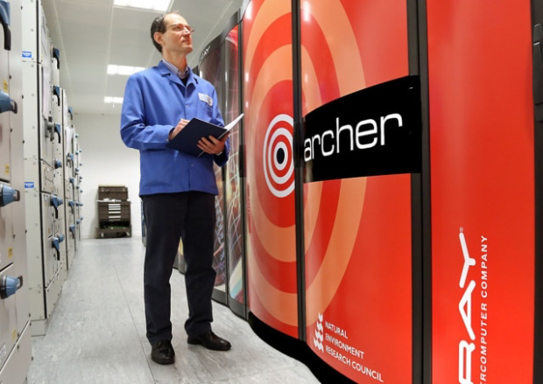
ARCHER Hardware
Pre/post-processing (PP) nodes
2 nodes
40 Intel Westmere cores per node
1 TB memory per node
Access to Lustre file system and RDF
Data Analytic Cluster (DAC)
12 compute nodes (20 Ivy Bridge cores, 128 GB memory)
2 high-memory nodes (40 Westmere cores, 2 TB memory)
High-bandwidth connectivity to RDF storage
Image: Gordon Fraser, www.scotsman.com

Slide 11
ARCHER Software
Fully-featured Cray Programming Environment
Cray, Intel and GNU compiler suites
Cray MPI & Libsci libraries
Many popular scientific libraries:
PETSc, HDF5 & NetCDF, FFTW…
Python
‘Native’ distribution (MPI4Py, NumPy, SciPy available…)
Anaconda distributions
Customisable with Virtual Environments
Debuggers and performance analysis tools
Allinea DDT
Cray Performance Analysis Toolkit
Find out more at: https://www.archer.ac.uk/documentation/

Slide 12
Routes to access
Access via Scientific consortia
Significant resources pre-allocated to EPSRC & NERC consortia:
Materials Chemistry Consortium
UK Turbulence Consortium
HEC Biomolecular Simulation Consortium
Oceanography
…
Access via ARCHER Driving Test
Small amount of compute time (1200 kAUs) for 12 months
Suitable for new users to ARCHER
Online training material and multiple-choice assessment
See https://www.archer.ac.uk/community/consortia/
See https://www.archer.ac.uk/training/online/driving_test.php
Notes:
1200 kAU = 3333 node hours = 1/3 million

Slide 13
Routes to access
Access via EPSRC & NERC Grants
ARCHER time may be included in research grant applications / fellowships etc.
Need to complete an ARCHER Technical Assessment (TA), which is submitted along with your application
10 days turnaround
Access via ARCHER Calls (EPSRC only)
ARCHER Resource allocation panel (RAP)
Significant amounts of compute resource (>1 MAUs, 1 year)
‘Instant Access’ for small projects (< 1.2 MAUs, 6 months)
See https://www.archer.ac.uk/access/
Current call closes 25th May 2017: https://www.epsrc.ac.uk/funding/calls/rapaccessarcherspring2017/
Notes:
1.2MAU = 1/3 M node hours

Slide 14



CSE Support
https://www.archer.ac.uk/safe
Email: support@archer.ac.uk
Phone: +44 (0)131 650 5000
**Support 0830-1800 Mon-Fri excluding UK Bank Holidays**

Slide 15

CSE Support
‘In-depth’ support
Porting & debugging codes
Software development support
Performance optimisation advice
Support for centrally installed software packages
ARCHER / HPC ‘Gurus’
Consortium contacts
Liaison between ARCHER service and scientific consortia
Understanding of key codes, methods & workflows
Provide tips, training, one-to-one support
Image: Jorge Cham, www.phdcomics.com
See https://www.archer.ac.uk/community/consortia/

Slide 16
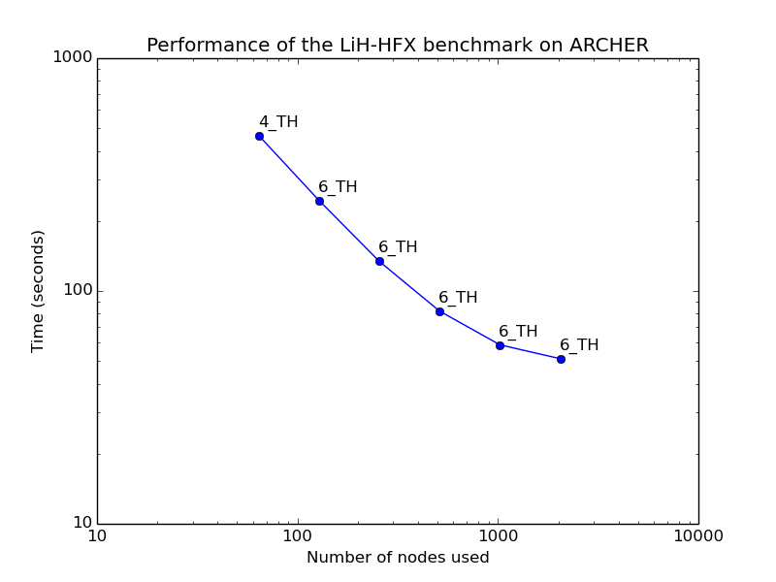
CSE Support
Scientific Software Packages
Relatively few users bring their own code to ARCHER
40+ popular packages are pre-installed
Optimised & tested
E.g. VASP, GROMACS, CP2K, OpenFOAM, Code_Saturne, FEniCS, Paraview…
License restrictions apply to some packages
Documentation, benchmark performance, scripts…
Often as easy as: module load cp2k
See https://www.archer.ac.uk/documentation/software/

Slide 17
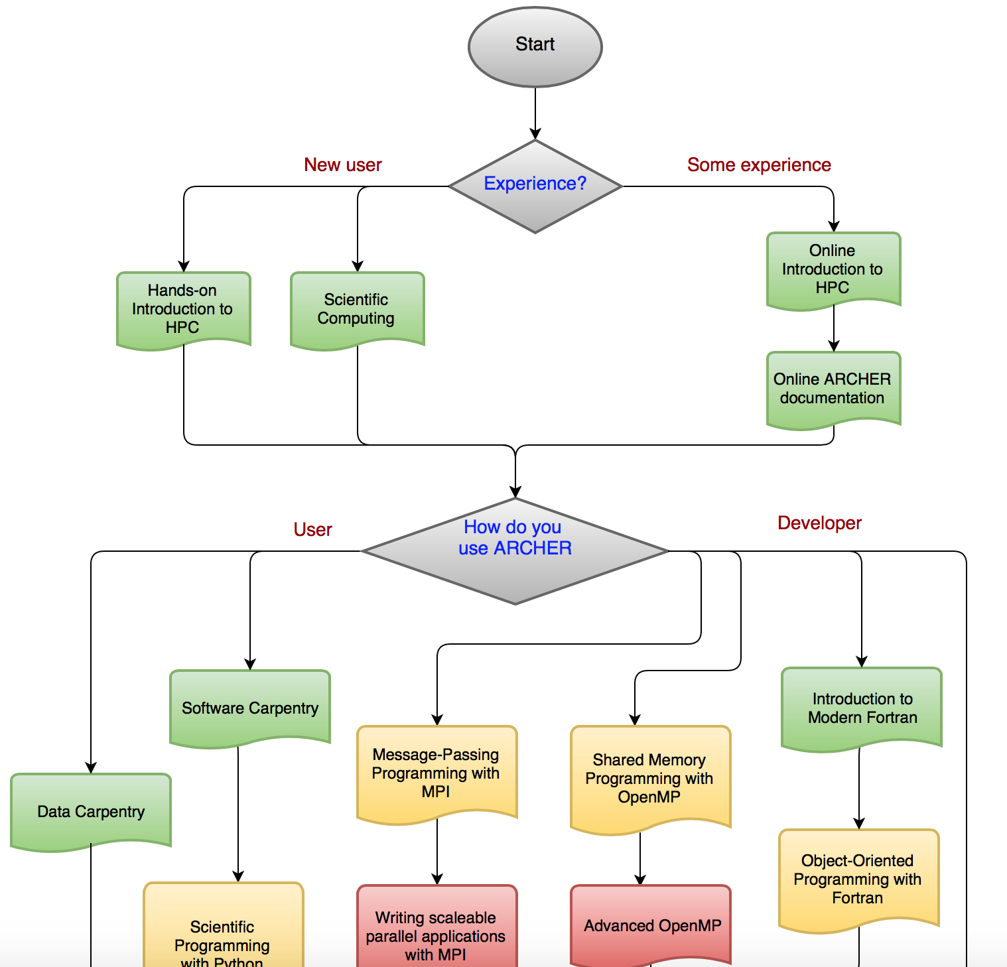
Training
Extensive training programme
Mix of online and classroom courses
Not just for existing ARCHER users (free to all academics)
Courses
Range of venues around the UK
Mixture of introductory / intermediate / advanced
Courses for ‘users’ and ‘developers’
All material archived on the web!
Virtual Tutorials / Webinars
3pm, Wednesdays
Presentation / live demos and Q&A
See https://www.archer.ac.uk/training/

Slide 18
Embedded CSE Funding
Regular calls for software development projects:
To sustain development of key applications on ARCHER
To facilitate efficient use of ARCHER resources through enhanced code performance/functionality
Code porting/scale-up from Tier-2/3, bringing new communities onto ARCHER
3-12 person-months
Effort provided by EPCC, Institutional RSEs, group members…
Expect close interaction with ARCHER CSE team
Calls 3 or 4 times per year
See https://www.archer.ac.uk/community/eCSE
Current call closes on 9th May
Next (final) call closes 12th Sept

Slide 19
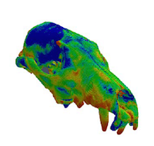
Embedded CSE Funding
Some recent projects:
“Adding Multiscale Models of DNA to the LAMMPS Molecular Dynamics code”
12 PMs EPCC staff effort
New functionality
“VOX-FE: New functionality for new communities”
6 PMs Postdoc at Hull, 3 PMs EPCC
New GUI for model setup and analysis, improved load balancing
“Enabling HPC for tools for the analysis of single molecule ion channel currents”
12 PMs UCL RSE team, re-architected and parallelised for ARCHER

Slide 20
Cirrus Tier-2
One of the new EPSRC Tier-2 Services
280 nodes
36 Intel Broadwell cores per node ➔ 10,080 cores
128 GB memory per node (~3.5 GB per core)
30% EPCC
Industry & research projects
70% EPSRC access
Instant Access – 7,000 CPUh for 6 months
National Open Access – TBC
EPSRC Grant Access
www.cirrus.ac.uk

Slide 21
Summary
ARCHER is the largest academic HPC resource in the UK
Supports ‘capability’ jobs of up to 100,000s CPU cores
Free access for EPSRC and NERC-remit research
Extensive training, support and documentation available
Funding for software development in support of research
www.archer.ac.uk

Slide 22

Any questions?
support@archer.ac.uk

